Slide 1
Bayesian Inference
Module 8, Lesson 1

Slide 2
Mixture Models
Shahrzad Jamshidi, PhD

Slide 3
Last Time
Regression models

Slide 4
Objectives
Understand the fundamentals of mixture models and their applications.
Learn to set up and interpret finite mixture models.

Slide 5
Topics to Review for This Lesson
Multinomial distributions
Dirichlet distributions

Slide 6
Mixture Distributions
Mixture distributions are combinations of two or more distributions
They arise when
Measurements of a random variable are taken under different conditions, where condition gives rise to a different distribution
Example: Measuring what witnesses remember from a surprise event will be a mixture of those paying attention and those distracted.
Samples are taken from a population consisting of two or more distinct subpopulations
Example: A distribution of adult heights would be a mixture of distributions broken down by gender.
Notes:
Mixture distributions are combinations of two or more distributions. They occur in situations where data can be categorized into different groups, each with its own distinct distribution.
When Do They Arise?
1. Different Conditions:
• Measurements of a random variable are taken under different conditions, where each condition gives rise to a different distribution.
• Example: Consider measuring what witnesses remember from a surprise event. The distribution of their memories would be a mixture of those who were paying attention and those who were distracted. Each group’s recollection follows a different distribution due to their varying levels of attention.
2. Distinct Subpopulations:
• Samples are taken from a population consisting of two or more distinct subpopulations.
• Example: The distribution of adult heights is a classic example. This overall distribution is a mixture of two distributions: one for male heights and one for female heights. Each subpopulation has its own distribution, and when combined, they form the overall mixture distribution.

Slide 7
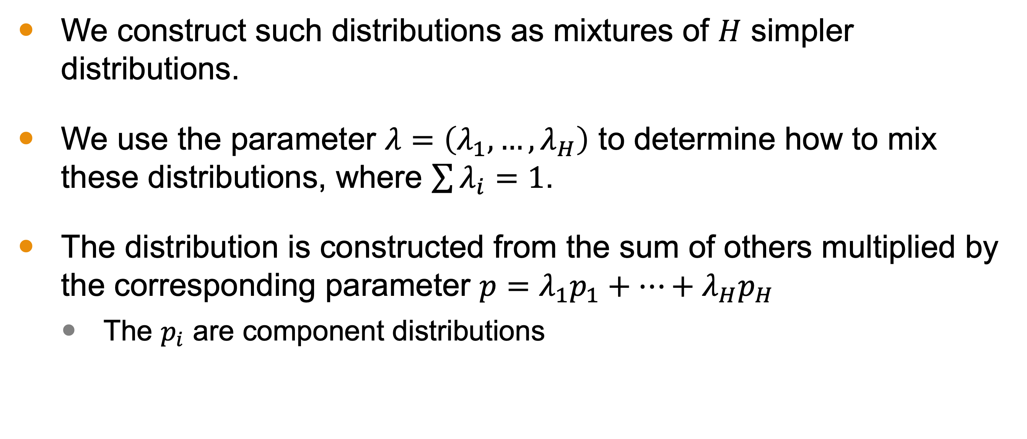
Approach
We construct such distributions as mixtures of $H$ simpler distributions.
We use the parameter $λ=\left(λ_{1},…, λ_{H}\right)$ to determine how to mix these distributions, where $\sum{λ_{i}}=1$.
The distribution is constructed from the sum of others multiplied by the corresponding parameter $p=λ_{1}p_{1}+…+λ_{H}p_{H}$
The $p_{i}$ are component distributions
Notes:
The approach involves constructing the distribution from H simpler distributions that we know and understand, such as several normal distributions with different means and variances.
We combine these multiple, simpler distributions by considering what proportion of the population corresponds to the subpopulation in question. For example, if we were thinking about adult heights, we might break up the population into subpopulations, such as females and males, although we may want additional distributions to account for folks who are intersex or who may have atypical hormonal development because maybe they are trans or they have something like McCune-Albright syndrome, which affects their development. Regardless of the number of subpopulations we identify, we know that these subpopulations do not exist in equal proportions within the larger population. So each one should have its own lambda value to reflect that. Lambda should reflect a proportion, so the sum of all the lambdas used should sum to 1.
So the larger distribution is the sum of the smaller distributions multiplied by lambda.

Slide 8
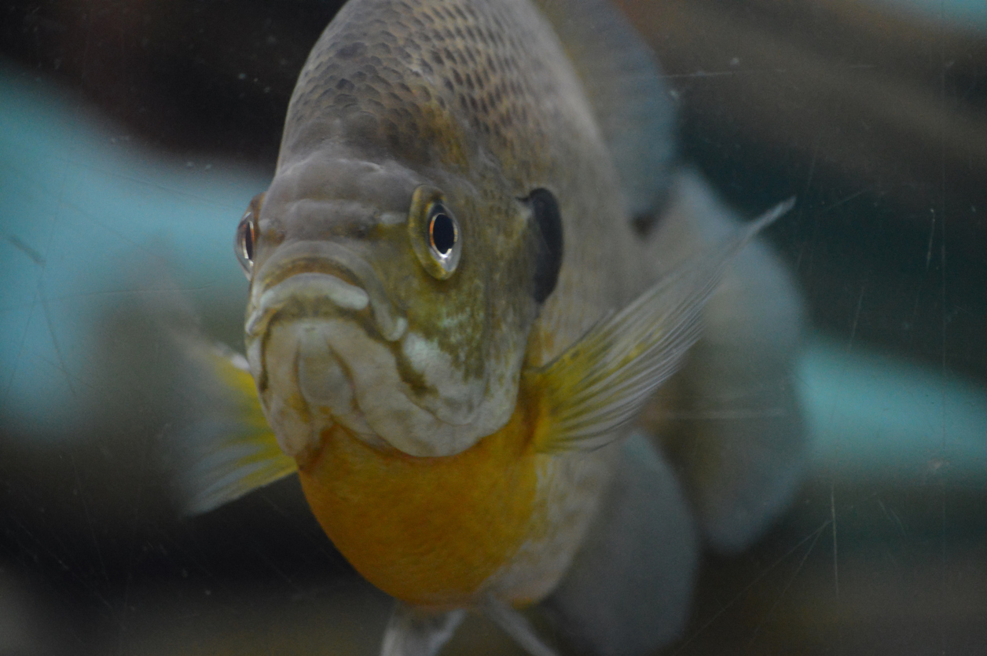
Mixture Example: Fish
Suppose we wish to construct the distribution lengths of a particular species of fish, Telmatochromis temporalis, in Lake Tanganyika in East Africa.
iStock-918633154 Credit - Trek13
Notes:
To get a sense of what we mean, let’s look at an example related to the Telmatochromis temporalis, a fish species in Lake Tanganyika in East Africa.

Slide 9
Mixture Example: Fish
Scientists have observed that the species consists of two ectomorphs: a big one that lives in the rocky shoreline (~40%) and a small one that lives among the shells in the sand (~60%).
Based on a metanalysis, you estimate that one population has a mean around 2 cm with a variance of 0.5, and the other population has a mean around 5 cm with a variance of 1.
Notes:
This is species is comprised of two subspecies of different lengths, which reside in different regions of the lake. Along the rocky shoreline exists the larger ectomorph and among the shells in the sand is the smaller one. Suppose they are 40% and 60% of the population total.
Then, suppose you metanalysis analysis where you construct a hierarchical model and estimate the following about the two populations. The smaller fish have a length of 2cm with a variance of 0.5 while the larger have a length of 5cm with a variance of 1.

Slide 10
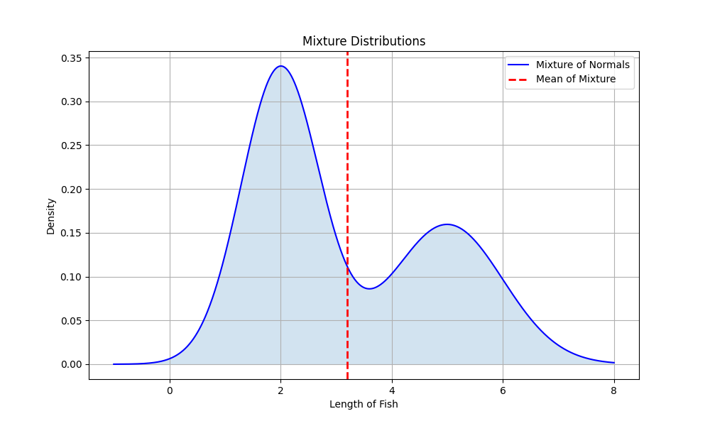
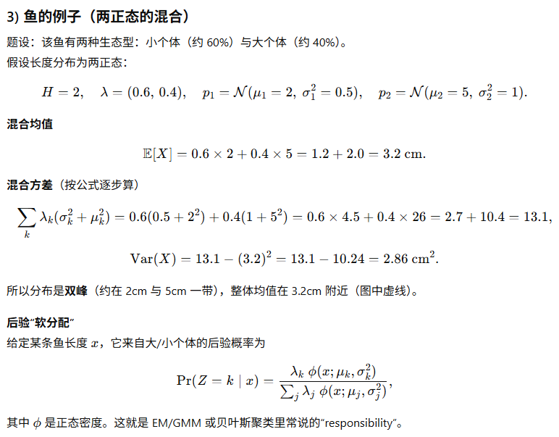
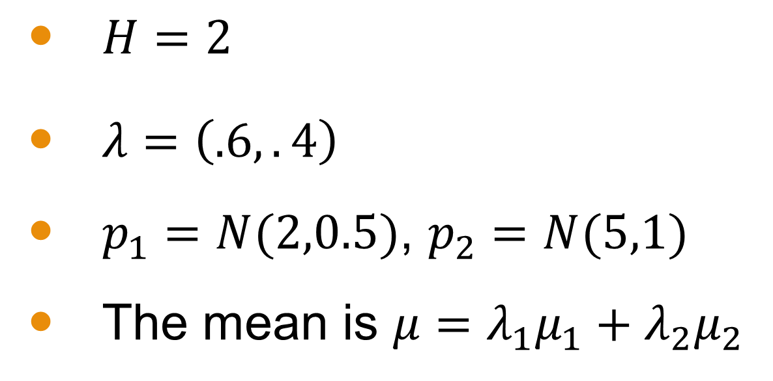
Example Distribution of the Fish
$H=2$
$λ=\left(.6,.4\right)$
$p_{1}=N(2,0.5)$, $p_{2}=N(5,1)$
The mean is $μ=λ_{1}μ_{1}+λ_{2}μ_{2}$
Notes:
Here is what that distribution of the assumed fish population is. You can see that it looks like two overlapping normal distributions. The x-axis of this graph correspond to fish lengths and the y-axis corresponds to the density. Based on what we’ve covered previously, you may notice that he mode is not particularly meaningful here since we really have two peaks. And because our distribution is not symmetric about a single peak, a normal approximation would not make sense here. The two distinct peaks would make us label it a bimodal distribution.
For this problem, H = 2 because we this distribution is constructed from only two subpopulations.
The lambda values are .6 and .4 corresponding to the frequencies of the populations. Note that lambda are generally parameters we estimate. So I might start off with some initial value value like we have here, but I may want to incorporate some uncertainty. How might I do this?
The two distributions we used to construct this are normal distributions. One with mean 2 and variance 0.5 and the other with mean 5 and variance 1.
The mean of the mixture population is combined by looking at the means of the individual distributions weighted according to the respective lambda populations. But this, on its face is not a particularly meaningful metric relative to the distribution.

Slide 11
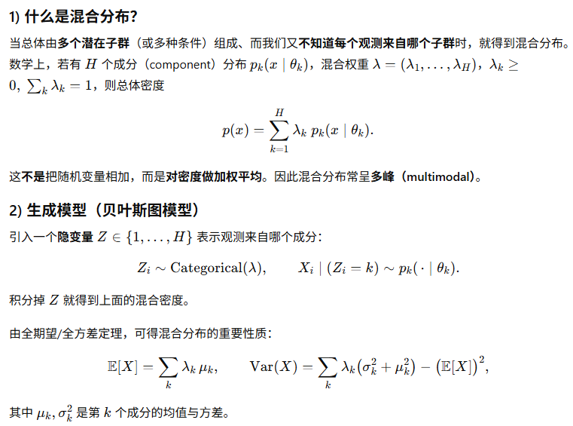
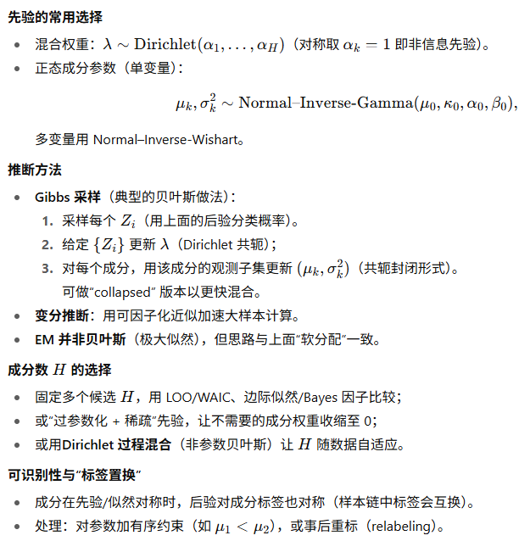
Summary: Mixture Distributions

Slide 12
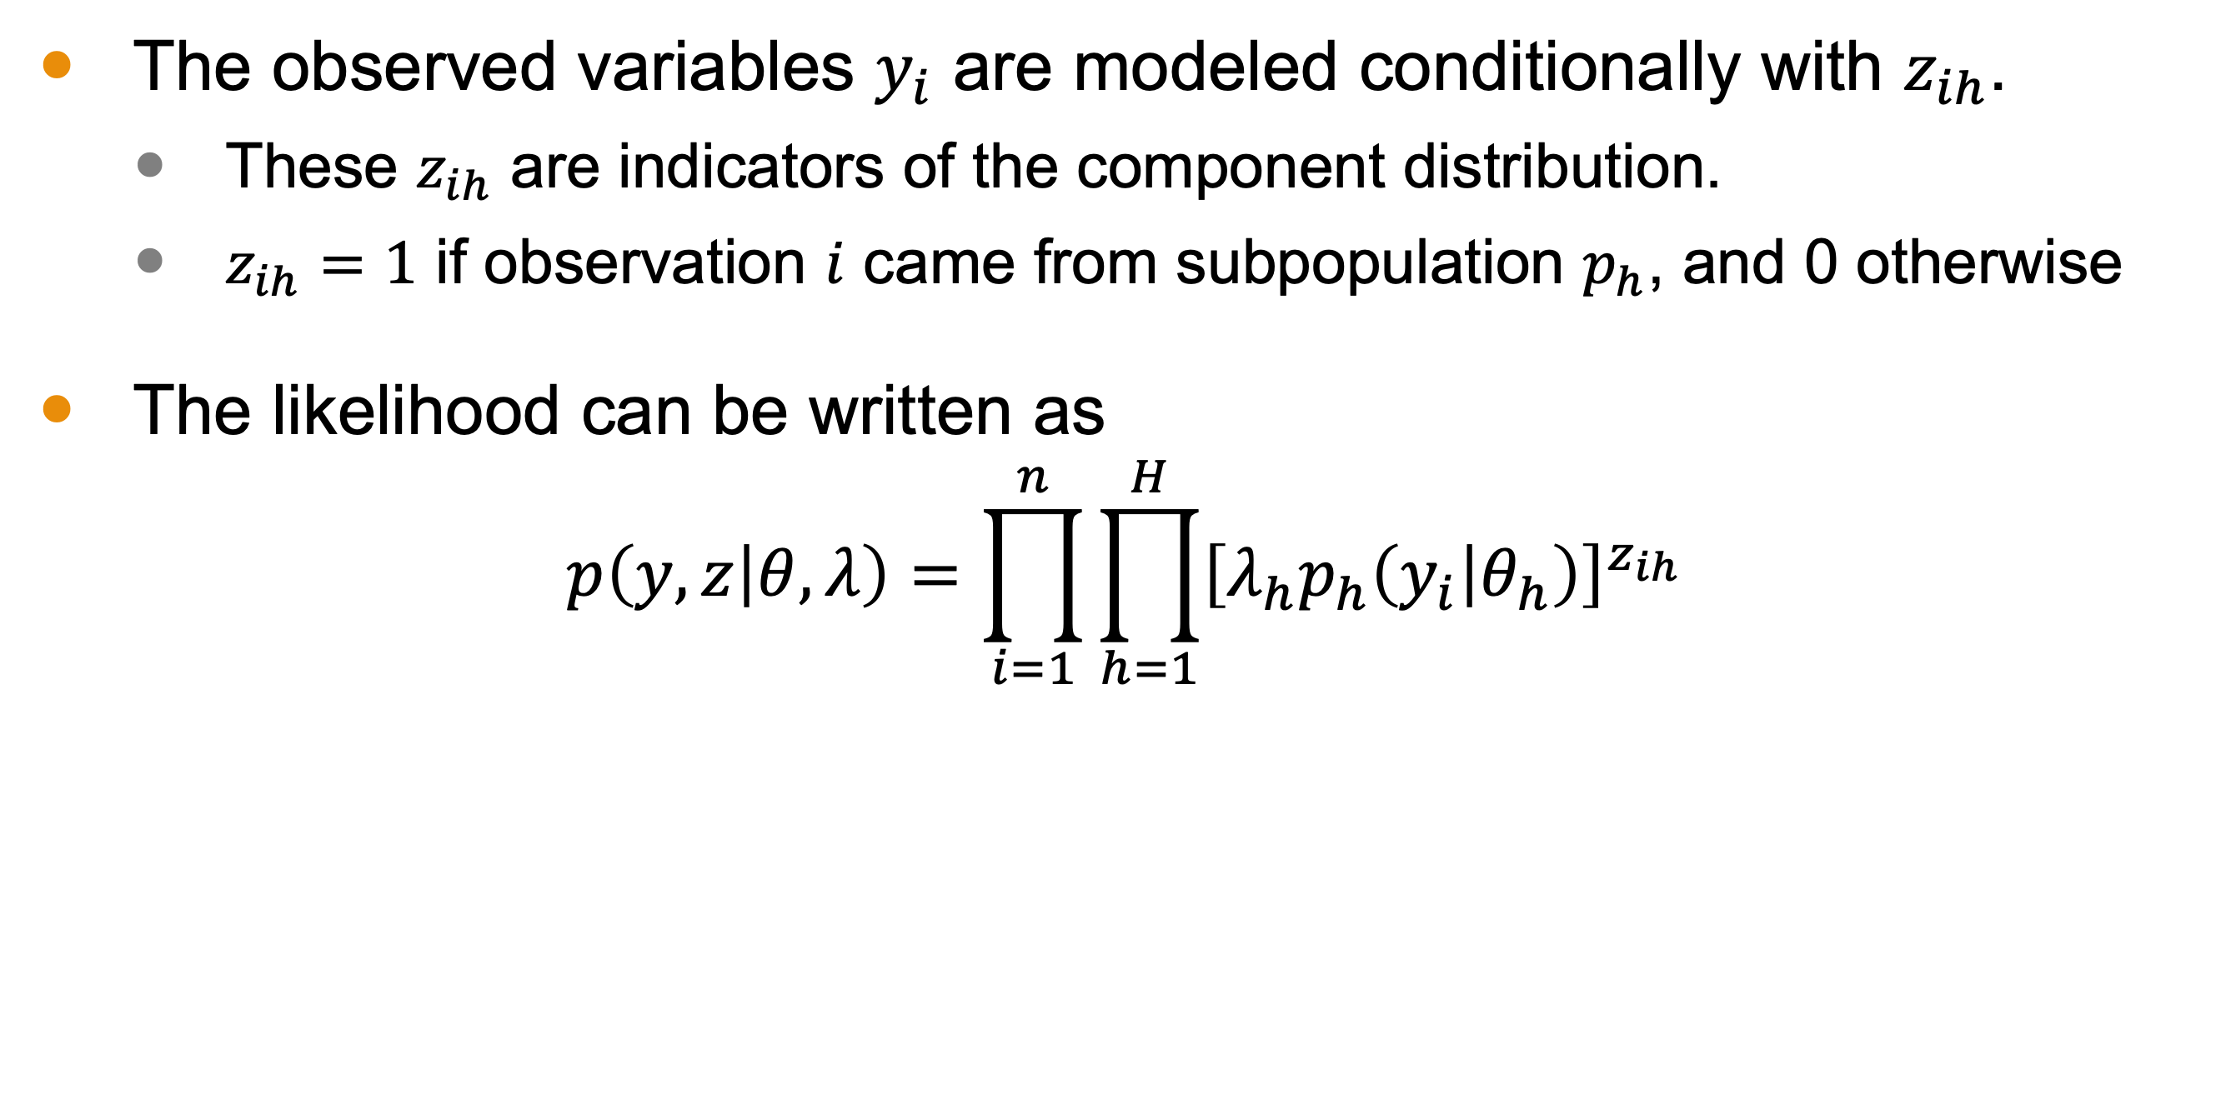
Finite Mixture Likelihood
The observed variables $y_{i}$ are modeled conditionally with $z_{ih}$.
These $z_{ih}$ are indicators of the component distribution.
$z_{ih}=1$ if observation $i$ came from subpopulation $p_{h}$, and 0 otherwise
The likelihood can be written as
$$p\left(y,z | θ,λ\right)=\prod_{i=1}^{n}{\prod_{h=1}^{H}{{\left[λ_{h}p_{h}\left(y_{i} | θ_{h}\right)\right]}^{z_{ih}}}}$$
Notes:
The observed variables are modeled using an indicator, z_ih. If the value of z_ih is 1, then that tells us that observation $i$ comes from component distribution $h$.
The likelihood of observations, which involves both the observation and the indicator variable can be written with this expression
with exactly one of zih equaling 1 for each i. Right now, we assume H, the number of mixture components, is known and fixed. But realistically, this would be something we’d seek to assess and could be thought of as a model’s hyperparameter—one where we might not opt to have a hyperprior because we can easily modify it when we evaluate the model. We will consider this issue further when discussing model checking.

Slide 13
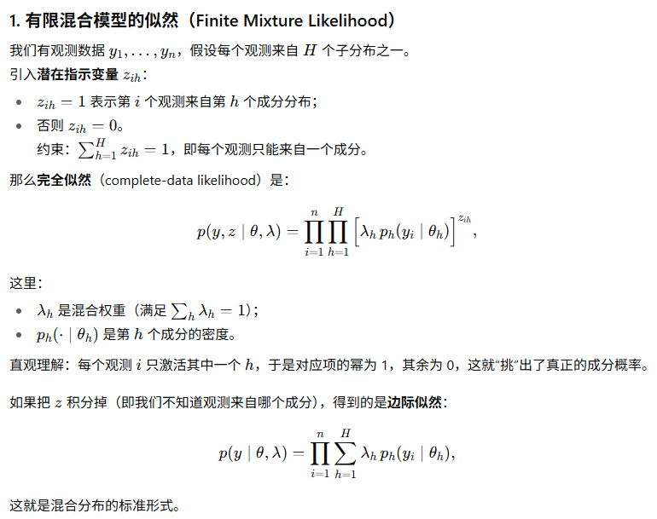
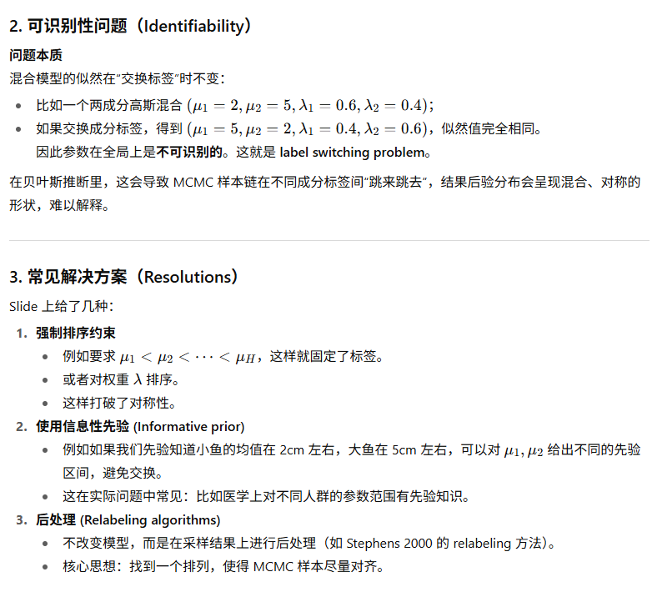
Finite Mixture Likelihood

Slide 14
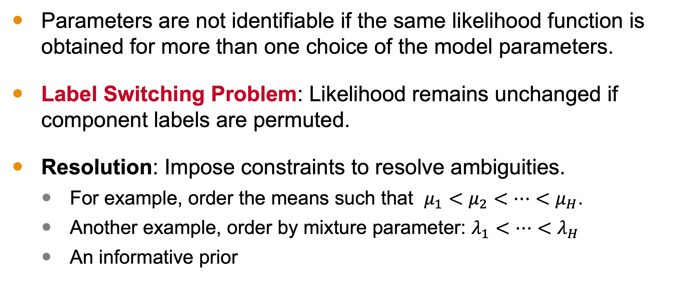
Identifiability
Parameters are not identifiable if the same likelihood function is obtained for more than one choice of the model parameters.
Label Switching Problem: Likelihood remains unchanged if component labels are permuted.
Resolution: Impose constraints to resolve ambiguities.
For example, order the means such that $μ_{1}<μ_{2}<…<μ_{H}$.
Another example, order by mixture parameter: $λ_{1}<…<λ_{H}$
An informative prior
Notes:
Parameters in a model are not identifiable if the same likelihood function is obtained for more than one choice of the model parameters. If I am considering parameters $θ_{1}$ and $θ_{2}$, but my observations are equally likely under both possibilities, then I cannot choose between $θ_{1}$ and $θ_{2}$. And this turns out to be an issue when dealing with mixture distributions.
In fact, all finite mixture models are nonidentifiable because I can permute the group labels and the distribution remains unchanged. That’s because the labels themselves are not meaningful. In the fish example, the smaller subpopulation was labeled as component 1, but if I were attempting to solve for the distribution—a valid solution would consider this population being component 2 as well. There was nothing that required that this subpopulation correspond to component 1.
When possible, we avoid this ambiguity. For example, we can specifying the means of the mixture components to be in nondecreasing order. In that case, the smaller fish HAVE to be in component 1. Another way we can impose an order is by the lambda values or specifying the mixture proportions λH to be nondecreasing. An informative prior can also resolve this somewhat as well.

Slide 15
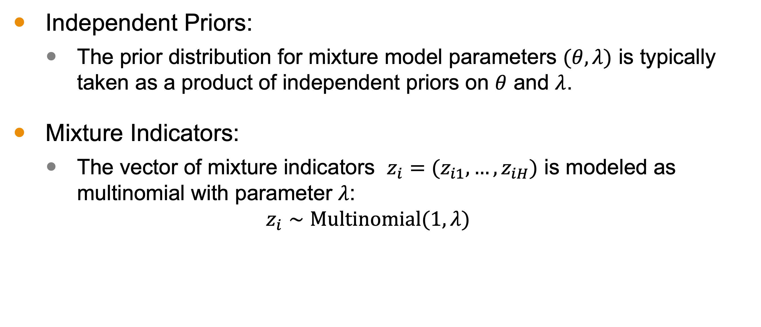
Prior Distributions
Independent Priors:
The prior distribution for mixture model parameters $(θ, λ)$ is typically taken as a product of independent priors on $θ$ and $λ$.
Mixture Indicators:
The vector of mixture indicators $z_{i}=(z_{i1}, …, z_{iH})$ is modeled as multinomial with parameter $λ$:
$$z_{i}∼Multinomial(1, λ)$$
Notes:
Let’s discuss the prior distribution for finite mixture models.
Independent Priors:
In most applications, the prior distribution for the mixture model parameters (\theta, \lambda) is taken as a product of independent prior distributions on \theta and \lambda. This simplifies the modeling process by allowing us to treat the parameters separately.
Mixture Indicators:
The vector of mixture indicators z_i = (z_{i1}, \ldots, z_{iH}) is modeled as a multinomial distribution with parameter \lambda. This means each z_i indicates which component the observation belongs to:
z_i \sim \text{Multinomial}(1, \lambda)
where \lambda_h represents the probability of the observation coming from the h -th component.
Dirichlet Prior:
For the mixture proportions \lambda, we use the Dirichlet distribution as a natural conjugate prior:
\lambda \sim \text{Dirichlet}(\alpha_1, \ldots, \alpha_H)
The relative sizes of the Dirichlet parameters \alpha_h describe the mean of the prior distribution for \lambda. The sum of \alpha_h values represents the strength of the prior, often referred to as the ‘prior sample size’.

Slide 16
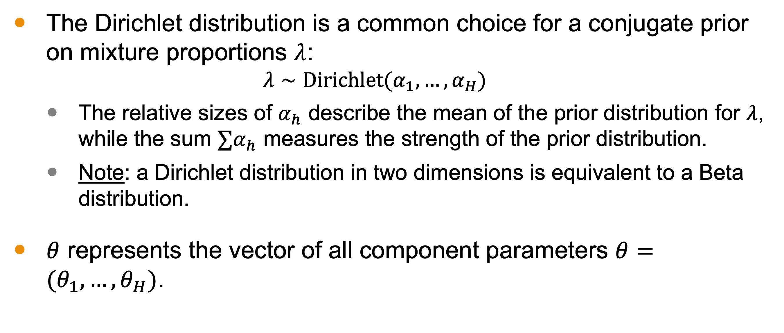
Prior Distributions
The Dirichlet distribution is a common choice for a conjugate prior on mixture proportions $λ$:
$$λ∼Dirichlet(α_{1}, …, α_{H})$$
The relative sizes of $α_{h}$ describe the mean of the prior distribution for $λ$, while the sum $∑α_{h}$ measures the strength of the prior distribution.
Note: a Dirichlet distribution in two dimensions is equivalent to a Beta distribution.
$θ$ represents the vector of all component parameters $θ=(θ_{1}, …, θ_{H})$.
Notes:
Dirichlet Prior:
For the mixture proportions \lambda, we use the Dirichlet distribution as a natural conjugate prior:
\lambda \sim \text{Dirichlet}(\alpha_1, \ldots, \alpha_H)
The relative sizes of the Dirichlet parameters \alpha_h describe the mean of the prior distribution for \lambda. The sum of \alpha_h values represents the strength of the prior, often referred to as the ‘prior sample size’.
Component Parameters:
The parameter vector \theta includes all the component parameters: \theta = (\theta_1, \ldots, \theta_H). Some parameters might be common to all components, while others are specific to a single component. For example, in a mixture of normal distributions, we might assume that the variances are the same for each component but that the means differ.

Slide 17
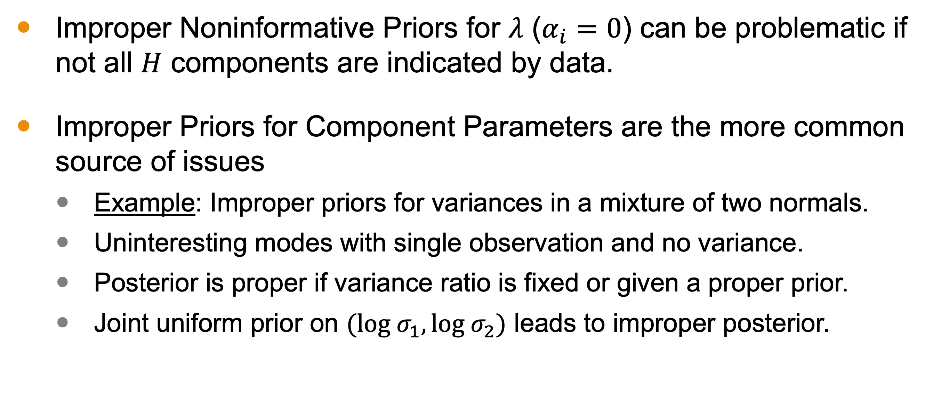
Ensuring a Proper Posterior Distribution
Improper Noninformative Priors for $λ$ ($α_{i}=0$) can be problematic if not all $H$ components are indicated by data.
Improper Priors for Component Parameters are the more common source of issues
Example: Improper priors for variances in a mixture of two normals.
Uninteresting modes with single observation and no variance.
Posterior is proper if variance ratio is fixed or given a proper prior.
Joint uniform prior on $(log σ_{1}, log σ_{2})$ leads to improper posterior.
Notes:
As we have discussed throughout this course, it is crucial to check that the posterior distribution is proper.
An improper noninformative prior—which is where some alpha are zero—may cause a problem if the data do not indicate that all H components are present in the data.
But a more common source of problems come from improper prior distributions used for the component parameters.
For instance, assuming an improper prior distribution for the variances in a mixture of two normal distributions can lead to problems. This is analogous to the problem discussed within the materials of Module 4 on a mixture of two normal distributions.
When dealing with a mixture of two normal distributions, we often encounter uninteresting modes. These modes correspond to a mixture component consisting of a single observation with no variance.
To ensure a proper posterior distribution in this case, we can fix the ratio of the two unknown variances or assign a proper prior distribution to this ratio.
With one exception: a joint uniform prior on (\log \sigma_1, \log \sigma_2). This will also result in an improper posterior distribution.

Slide 18

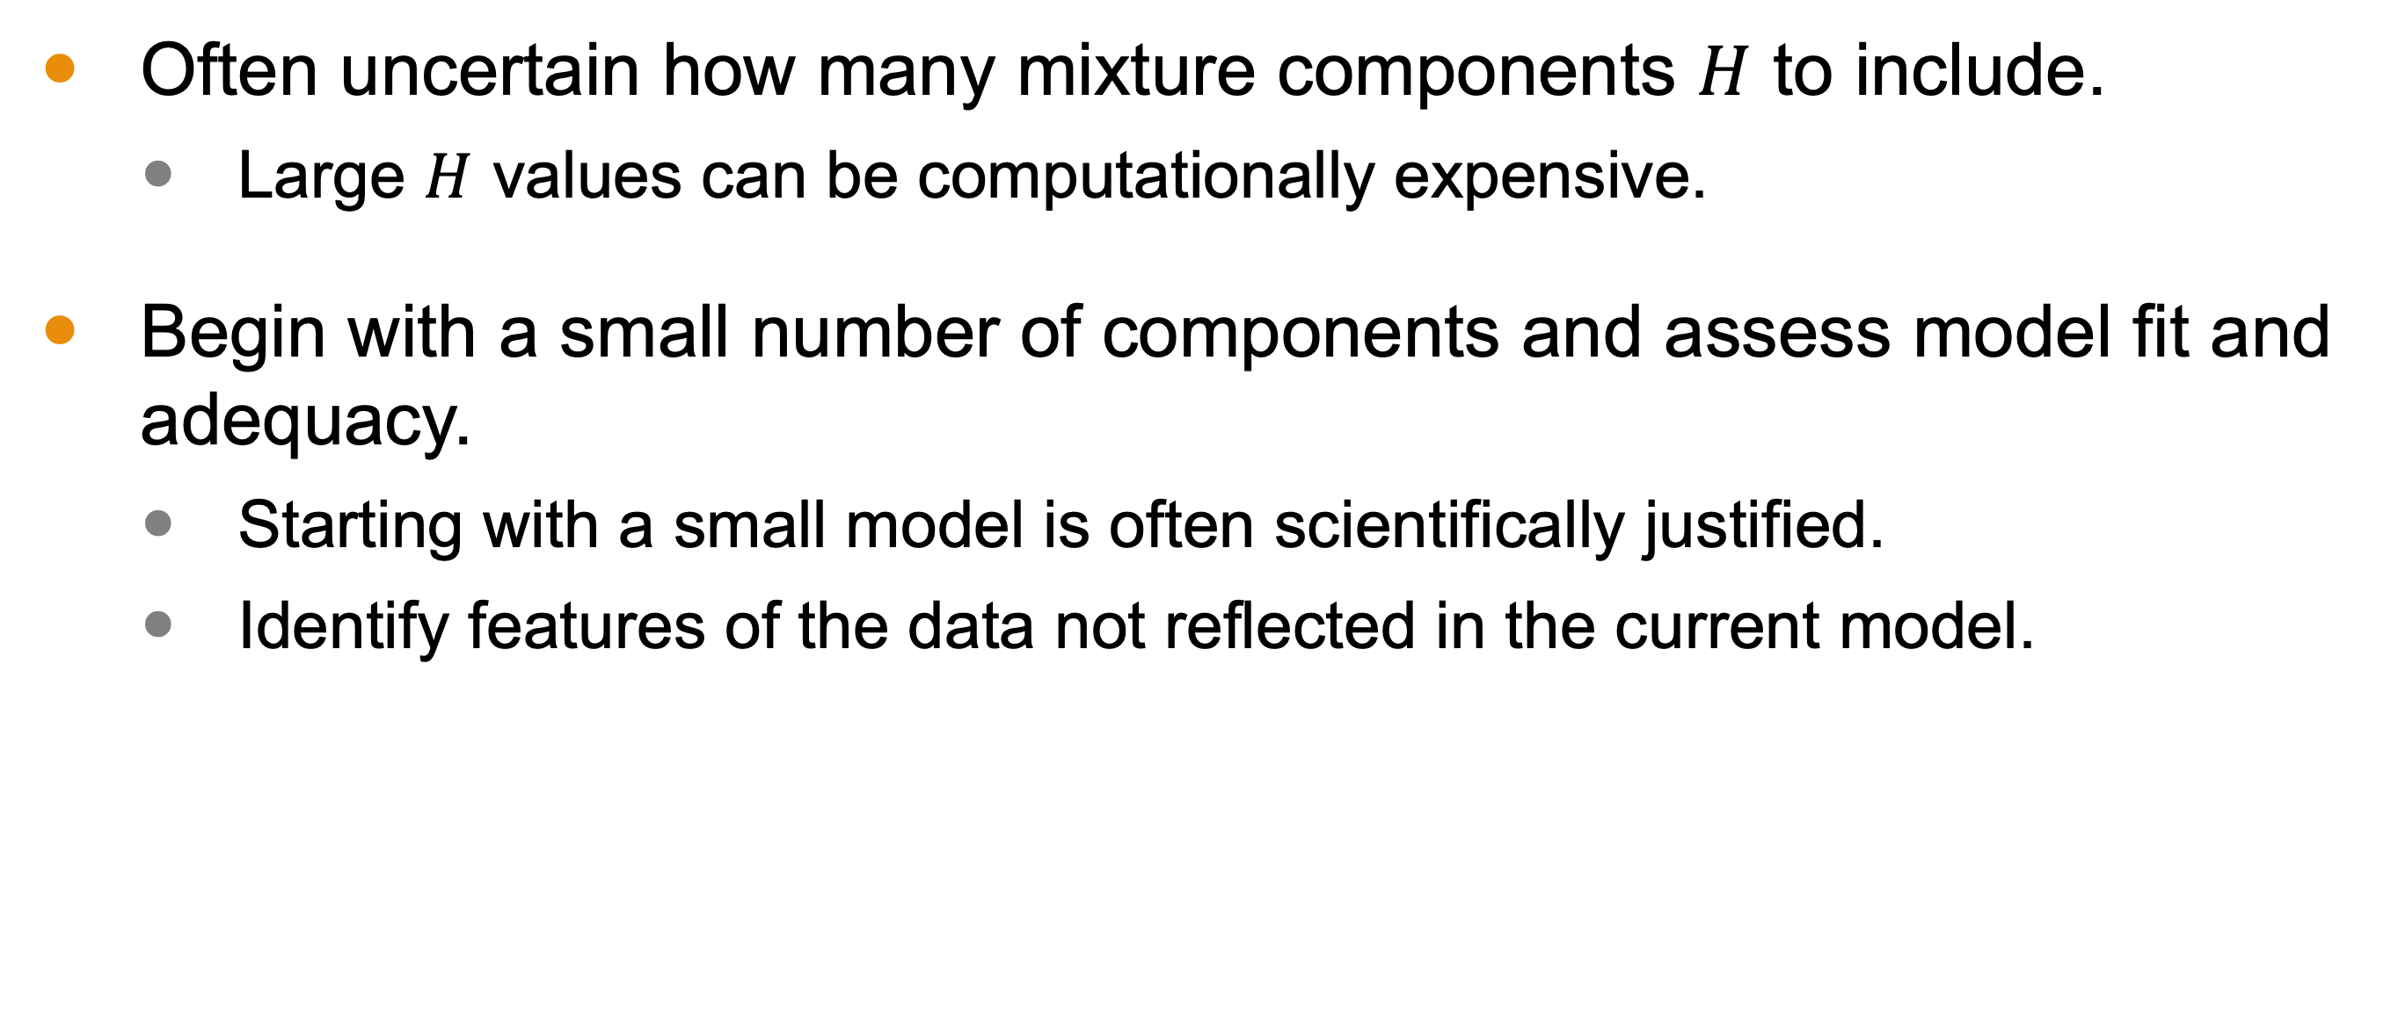
Number of Mixture Components $H$
Often uncertain how many mixture components $H$ to include.
Large $H$ values can be computationally expensive.
Begin with a small number of components and assess model fit and adequacy.
Starting with a small model is often scientifically justified.
Identify features of the data not reflected in the current model.
Notes:
So far, we have talked about the set up of a mixture model, including the likelihood and some considerations with respect to the prior. But one element that is important to discuss is how we might determine the number of components, which is often unknown to us. Recall, though, that while this may be a hyperparameter, we will not model it with a hyperprior. Instead, we take an approach similar to what is seen in Statistical Learning, where we aim to find an optimal choice through trial and error.
One important factor here is that we have a lurking computational issue. We don’t want a very large H as it makes modeling intractable.
Start Small:
It’s often best to begin with a small number of components and assess the model’s fit. Starting small allows us to evaluate the model’s adequacy without overburdening our computational resources.

Slide 19
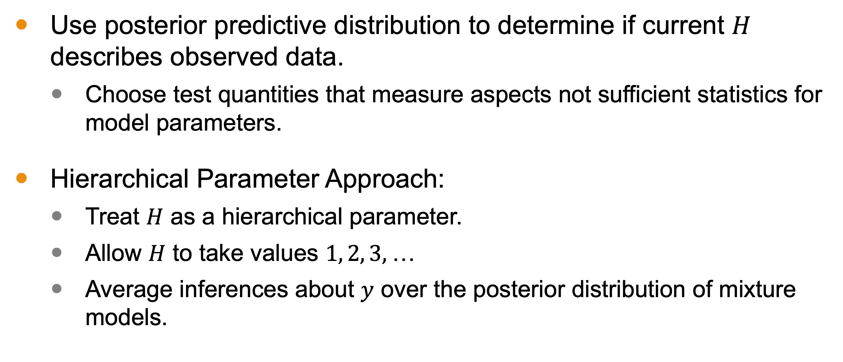
Number of Mixture Components $H$
Use posterior predictive distribution to determine if current $H$ describes observed data.
Choose test quantities that measure aspects not sufficient statistics for model parameters.
Hierarchical Parameter Approach:
Treat $H$ as a hierarchical parameter.
Allow $H$ to take values $1, 2, 3,$…
Average inferences about $y$ over the posterior distribution of mixture models.
Notes:
Posterior Predictive Distribution:
To determine if the current number of components H adequately describes the observed data, we use the posterior predictive distribution of a suitably chosen test quantity. This test quantity should measure aspects of the data that are not sufficient statistics for the model parameters, providing a clear indication of the model’s fit.
Hierarchical Parameter Approach:
An alternative approach is to treat H as a hierarchical parameter. In this framework, H can take on values 1, 2, 3, and so on. We then average our inferences about y over the posterior distribution of mixture models, providing a more flexible and comprehensive understanding of the data.

Slide 20
Interpreting Mixture Distributions
Two schools of thought:
True Models
Subpopulations are real.
Challenge: clustering and identifying subpopulations is highly sensitive.
Approximating distributions
Finite mixture models are flexible and can better approximate a distribution.
Broad applications
Univariate or multivariate density estimation.
Classification tasks.
Nonparametric regression.
Notes:
Let’s explore the two schools of thought on finite mixture models: treating them as true models or as approximating distributions.
Viewpoint 1: True Models
The first viewpoint considers the incorporation of latent subpopulations as a realistic characterization of the true data-generating mechanism. Here, subpopulations are seen as truly existing, and there is interest in performing inferences on these subpopulations and clustering individuals based on their subpopulation membership. This approach has led to extensive literature on latent class modeling and model-based clustering.
Challenges with Viewpoint 1:
However, clustering and identifying subpopulations are highly sensitive to the parametric model f used, which suggests they might not be real. For instance, changing f from a normal distribution to a t-distribution can result in very different clusters. In multivariate cases, using a diagonal covariance can inflate the number of clusters, splitting true elliptical subpopulations into several spherical subgroups to fit the data. Thus, since the true parametric model is never fully known, the reliability of estimated cluster-specific parameters or clusters is questionable.
Viewpoint 2: Approximating Distributions
The second viewpoint argues that trying to infer latent subpopulations is an intrinsically ill-defined statistical problem. Instead,
finite mixture models are valued for their flexibility in building more realistic hierarchical models. They better account for uncertainty in parametric choices for random effects, error distributions, and other aspects of the model.
Applications of Finite Mixture Models:
Finite mixture models have broad applications, including:
• Univariate or multivariate density estimation.
• Classification tasks, where data is categorized into different groups.
• Nonparametric regression, which does not assume a fixed functional form for the relationship between variables.

Slide 21
Posterior Simulation Using the Gibbs Sampler
Starting values are obtained via importance resampling.
Gibbs Sampler alternates between two major steps:
Drawing indicators given model parameters.
Drawing model parameters given indicators.
Errors like improper priors may be detected during iterative simulations.
Identifiability issues may arise if Gibbs sequences do not converge due to aliasing in component permutations.
Notes:
As you might expect, for models this complicated, we would expect to simulate our posterior and posterior predictive distributions.
Posterior Simulation Using the Gibbs Sampler:
We begin with obtaining starting values for the Gibbs sampler. These can be acquired through importance resampling from a suitable approximation to the posterior, such as a mixture of t_4 distributions located at the modes.
The Gibbs sampler alternates between two main steps:
1. Drawing indicators given the model parameters.
2. Drawing model parameters given the indicators.
The second step might involve several updates to all model parameters. When we have the indicators, the mixture model simplifies to an ordinary (possibly hierarchical) model. This is where the use of conjugate priors can be very helpful, as they simplify the calculations involved.
Drawing indicators is typically straightforward, often involving multinomial draws in finite mixture models.
During the iterative simulation stage, modeling errors like incorrect application of an improper prior density can become apparent. For instance, if a Gibbs sequence starts near zero variance, it may never move away from that area. Identifiability issues may also become evident if the Gibbs sequences do not converge due to aliasing in permutations of the components.

Slide 22
Posterior Inference
Once the Gibbs sampler has reached approximate convergence, ignore the drawn indicators for posterior inferences.
Posterior distribution of indicator variables informs about the likely components for each observation.
Assess fit using posterior predictive checks.
Evaluate sensitivity of inferences to the assumed parametric family to ensure robustness.
Notes:
Once the Gibbs sampler has reached approximate convergence, we can obtain posterior inferences about the model parameters by ignoring the drawn indicators. The posterior distribution of the indicator variables gives us information about the likely components from which each observation is drawn.
To assess the fit of the model, we can use various posterior predictive checks, as illustrated in the next lesson. If robustness is a concern, we can evaluate the sensitivity of our inferences to the assumed parametric family using the methods discussed in Chapter 17 of BDA3, our textbook.
By carefully applying these techniques, we can ensure that our mixture models are both accurate and robust, providing reliable insights into the data.

Slide 23
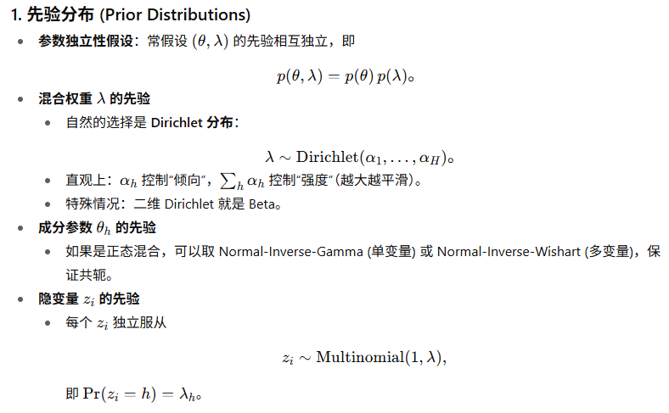
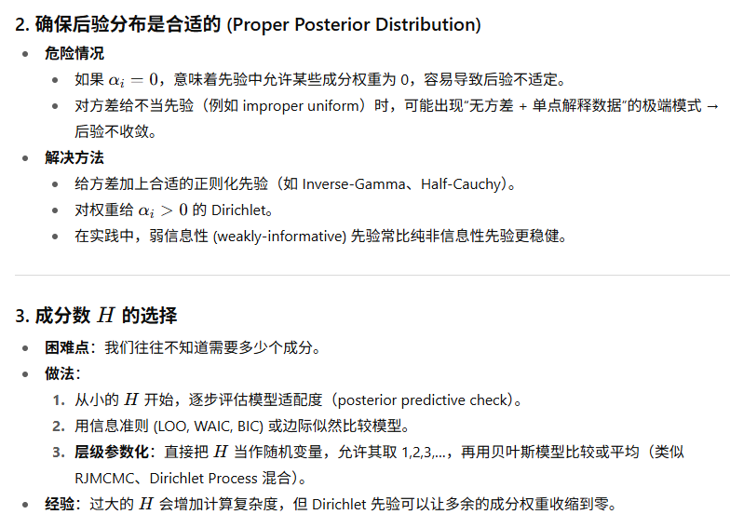
Summary 贝叶斯有限混合模型的全流程
Notes:
Next time, we discuss practical applications and some computational challenges related to mixture models.

Slide 24
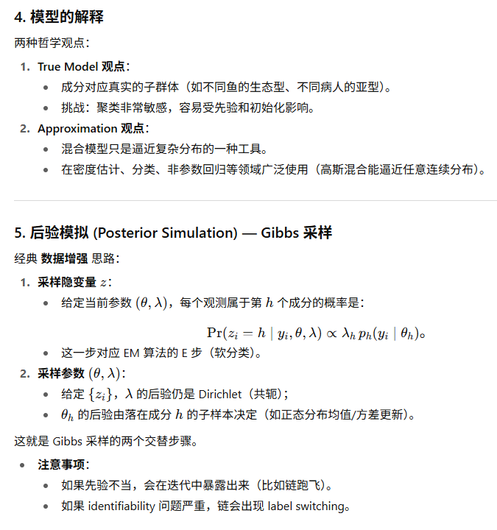
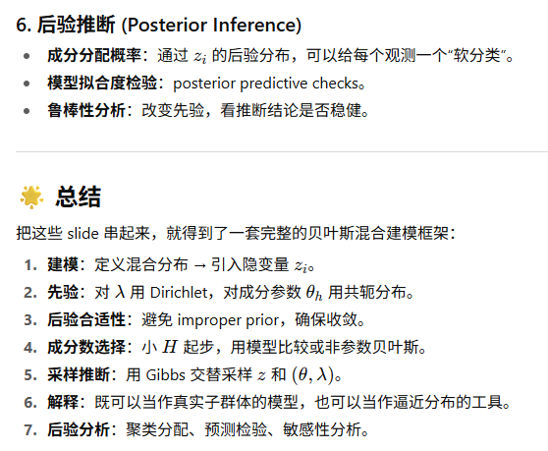
Summary 贝叶斯有限混合模型的全流程
Notes:
Next time, we discuss practical applications and some computational challenges related to mixture models.

Slide 25
Next Time
Practical Applications and Computational Challenges
Notes:
Next time, we discuss practical applications and some computational challenges related to mixture models.

